Slide 1
FLORIDA’S BIOMEDICAL RESEARCH ADVISORY COUNCIL UPDATE May 20, 2022
Daniel Armstrong, PhD
Chair, Florida Biomedical Research Advisory Council

Slide 2
Affiliations
Affiliations
Department of Pediatrics and Sylvester Cancer Center, University
of Miami (UM) Miller School of Medicine
Holtz Children’s Hospital at UM/Jackson Memorial Medical Center
American Cancer Society (Representative to
the Biomedical Research Advisory Council (BRAC))
Florida Association of Children’s Hospitals (FACH)-President
Association of University Centers on Disability (AUCD)-President-elect
Early Learning Coalition of Miami-Dade/Monroe-Vice Chair

Slide 3
Driving Principles For Research Grant Awards
Intentionally create “Critical Mass” of research to address Strategic Goals
Create synergy among Florida investigators to more rapidly advance progress toward Strategic Goals
Use the Biomedical Research Grant Program to drive collaboration between investigators across Florida’s cancer research institutions
Notes:
Priorities:
Advance knowledge of prevention, diagnoses, treatments, and cures
Build research infrastructure in the state of Florida
Secure external funding
Stimulate economic activity

Slide 4
Current Funding and Active Grants
James and Esther King Biomedical Research Program
$8 million available to award research grants in Fiscal Year (FY) 2021-2022
Lawton Chiles Endowment will end July 1, 2022 (reducing award total up to $2.1 million annually)
70 active research grants
Bankhead-Coley Cancer Research Program
$10 million available to award research grants in FY 2021-2022
$500,000 appropriated annually to the McKnight Brain Institute paid for through this fund
79 active research grants
Live Like Bella Pediatric Cancer Research Initiative
$3 million available to award research grants in FY 2021-2022
35 active research grants

Slide 5
Awarded Institutions from 2006 through 2022
Notes:
All Children’s Research Institute
Carlos Albizu University
Mount Sinai Medical Center of Florida
Ave Maria University
Haley VA Hospital
Saneron CCEL Therapeutics
Bay Pines VA Health Care System
M.D. Anderson Cancer Center
Sanford-Burnham
Edward Waters College
Mayo Clinic
The Scripps Research Institute
Florida Agricultural and Mechanical University
Miami Cancer Institute, Baptist Health South Florida
Torrey Pines Institute
Florida Atlantic University
Miami VA
University of Central Florida
Florida Hospital Cancer Institute
Moffitt Cancer Center
University of Florida
Florida Institute of Technology
Nano Discovery Inc.
University of Miami
Florida International University
Nemours Childrens Clinic
University of South Florida

Slide 6
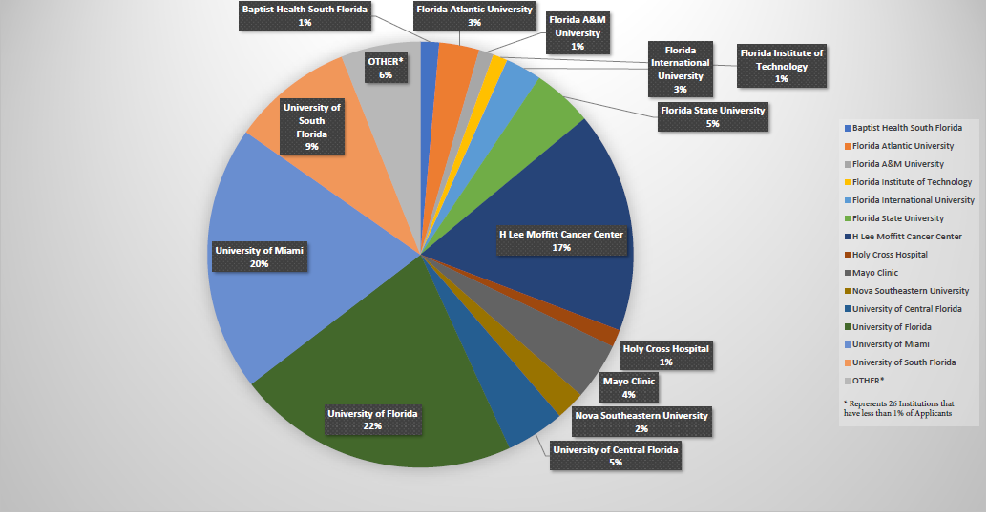
BRAC Applicants Based on Institution FY 2015-2022
Notes:
992 unique applicants from 40 institutions.

Slide 7
Bankhead-Coley Awards FY 2021-2022
Organization | Principal Investigator | Application Title | Mechanism of Support | Cancer Focus
H. Lee Moffitt Cancer Center and Research Institute | Vadaparampil, Susan | HPV MISTICS: HPV Multilevel Intervention Strategies Targeting Immunization in Community Settings | Clinical Research | 1) cervical cancer, 2) oropharyngeal cancer, 3) anal cancer, 4) vulvar cancer, 5) vaginal cancer, and 6) penile cancer
H. Lee Moffitt Cancer Center and Research Institute | Lau, Eric | The trouble with testosterone: delineating how androgen drives melanoma invasiveness and metastasis via fucosylation-regulated cellular adhesion | Discovery Science | melanoma
H. Lee Moffitt Cancer Center and Research Institute | Conejo-Garcia, Jose | Heterogeneity of metastatic small cell lung cancer; implications for the design of effective immunotherapies | Clinical Research | Lung cancer
H. Lee Moffitt Cancer Center and Research Institute | Smalley, Inna | Defining and targeting the immune-suppressive metabolic microenvironment of leptomeningeal melanoma metastases | High-Risk, High-Reward Discovery Science | Melanoma
H. Lee Moffitt Cancer Center and Research Institute | Kissil, Joseph | Establishing the functional differences between variant oncogenic KRAS alleles and identification of allele-selective inhibitors | Discovery Science | Lung cancer
H. Lee Moffitt Cancer Center and Research Institute | Manley, Brandon | Establishing the role of aberrant splice variants as a clinical biomarker in clear cell renal cell carcinoma | High-Risk, High Reward Clinical Research | kidney cancer
H. Lee Moffitt Cancer Center and Research Institute | Luca, Vincent | Structure-guided engineering of LAG3 immunomodualtory function | Discovery Science | Melanoma
Mayo Clinic | Thompson, E Aubrey | Spatial analysis of the immune landscape of stage 4 triple negative breast cancer | Discovery Science | stage 4 triple negative breast cancer
Nova Southeastern University | Minond, Dmitriy | Spliceosomal modulation for regulation of melanoma immunogenicity | Discovery Science | melanoma
The University of Florida | Licht, Jonathan | Mitochondrial modulators of multiple myeloma growth and therapy resistance | Discovery Science | multiple myeloma
University of Florida | Jin, Lingtao | The Role of Immune Microenvironment in Small Cell Lung Cancer | Bridge | Lung cancer
University of Miami | Barrientos, Antonio | Targeting mitochondrial protein synthesis to combat blood malignancies | Discovery Science | Blood malignancies: Leukemia and Lymphoma
H. Lee Moffitt Cancer Center and Research Institute | Monteiro, Alvaro | The role of WDR43 in ER-negative breast cancer | High-Risk, High-Reward Discovery Science | breast cancer
Notes:
Yellow highlight denotes relinquished bridge grant

Slide 8
James and Esther King Awards FY 2021-2022
Organization | Principal Investigator | Application Title | Mechanism of Support | Tobacco Related Disease Focus
Mayo Clinic Florida | Ross, Owen | Creating a Florida Cerebrovascular Disease Biorepository and Genomics Center | Research Infrastructure | Stroke and cerebrovascular disease
Moffitt Cancer Center | Vidrine, Jennifer | Enhancing Long-Term Smoking Abstinence Among Cervical Cancer Survivors | Clinical Research | cervical cancer, lung cancer, breast cancer, colon cancer, melanoma, other tobacco-related diseases
University of Florida | Doonan, Bently | Novel RNA-Nanoparticle vaccine for treatment of early melanoma recurrence following adjuvant anti-PD-1 antibody therapy | Clinical Research | Melanoma
University of Florida | Law, Brian K. | Toward IND-Enabling Studies for Novel Cancer Therapeutics that Inhibit the Disulfide Isomerases ERp44, PDIA1, and AGR2 | Bridge | Breast Cancer
University of Florida | Liao, Daiqing | Development of first-in-class HDAC3-selective degraders for breast cancer therapy | Discovery Science | breast cancer
University of Miami | Nagathihalli, Nagaraj | Targeting CREB to Improve Response to Immunotherapy in Pancreatic Cancer | Discovery Science | Pancreatic Cancer
University of Miami | Vazquez-Padron, Roberto | The Impact of Smoking in the Venous Cellular Ecosystem and its Consequences for Arteriovenous Fistula Maturation in CKD Patients | Discovery Science | Tobacco-related diseases: Chronic Kidney disease, cardiovascular disease, and vascular access failure
University of South Florida | Li, Ji | Sirtuin 1 and Cardiovascular Impairment by Cigarette Smoking | Discovery Science | tobacco-related cardiovascular disease
University of South Florida | Mohapatra, Subhra | Mechanism of neurotropism by coronaviruses | Bridge | Other tobacco-related neurologic diseases, such as COVID19, stroke, encephalopathy, schizophrenia etc.
Notes:
Highlighted award was relinquished

Slide 9
Live Like Bella FY 2021-2022
Organization | Principal Investigator | Application Title | Mechanism of Support | Pediatric Cancer Focus
Baptist Health South Florida | Hall, Matthew | Personalizing radiotherapy dose using genomic markers of radiosensitivity to predict tumor response and normal tissue toxicity in pediatric malignancies. | Discovery Science | Pediatric brain tumors treated with radiation therapy
Nemours Childrens Hospital | Westmoreland, Tamarah | Treatment of Diffuse Intrinsic Pontine Glioma with the Oncolytic Zika Virus | Discovery Science | Diffuse Intrinsic Pontine Glioma
The University of Florida | Licht, Jonathan | Elucidation and targeting of epigenetic changes resulting in glucocorticoid resistance in pediatric acute lymphoblastic leukemia | Discovery Science | Acute lymphoblastic leukemia
University of Central Florida | Copik, Alicja | Edited Natural Killer cells as an immunotherapeutic approach for the treatment of pediatric cancers | Discovery Science | pediatric tumors
University of Central Florida | Parks, Griffith | Oncolytic virus in combination with NK cells for treatment of pediatric cancers | Discovery Science | Brain, sarcoma, kidney, pediatric
University of Florida | Deleyrolle, Loic | Co-opting TME lactate signal to benefit T cell therapy | Discovery Science | High grade glioma
University of Florida | Castillo, Paul | Unlocking CAR T cell efficacy against osteosarcoma using adjuvant RNA vaccine | Discovery Science | Osteosarcoma
University of Florida | Horn, Biljana | Engineered Donor Graft for Pediatric Hematopoietic Cell Transplant (HCT) Recipients with Hematologic Malignancies (HM)- Florida Pediatric Bone Marrow Transplant and Cell Therapy Consortium (FPBCC) First Prospective Multicenter Trial | Multicenter Clinical Trials | acute myeloid leukemia, acute lymphoid leukemia
University of Florida | Stover, Brian | Ultrasound elastogram assessment of liver fibrosis in children and adolescents/young adults (AYA) receiving chemotherapy or allogeneic bone marrow transplantation, and identification of risk factors for liver injury | Discovery Science | All pediatric cancers requiring cytotoxic chemotherapy
University of Florida | Salloum, Ramzi | Point-of-care intervention to address financial toxicity in families facing pediatric cancer | Multicenter Clinical Trials | All pediatric cancer

Slide 10
Annual Application Process
CURRENTLY
Notes:
FOA will be releasing in May 2022 earlier then the usual July 1st

Slide 11
Bankhead-Coley Applications and Awards
Notes:
10 year history

Slide 12
King Applications and Awards
Notes:
10 year history

Slide 13
Bella Applications and Awards
Notes:
5 years

Slide 14
Bankhead-Coley Awards and Budget
Notes:
Average additional budget needed to fund all proposals with a score of 3 or better = $19,570,505
Number of grants funded in FY 2016-2017 with current budget: 11
Number of grants funded in FY 2017-2018 with current budget: 12
Number of grants funded in FY 2018-2019 with current budget: 15
Number of additional grants for FY 2016-2017: 27
Number of additional grants for FY 2017-2018: 22
Number of additional grants for FY 2018-2019: 22
This figure does not include additional funds that would be needed to accommodate increased administrative cost (cost of conducting the peer review if increased funding attracts additional applicants, peer review honoraria, hiring additional grant managers, etc.).

Slide 15
James and Esther King Awards and Budget
Notes:
Average additional yearly budget needed to fund all proposals with a score of 3 or better = $16,662,468
Number of grants funded in FY 2016-2017 with current budget: 7
Number of grants funded in FY 2017-2018 with current budget: 9
Number of grants funded in FY 2018-2019 with current budget: 10
Number of additional grants for FY 2016-2017: 14
Number of additional grants for FY 2017-2018: 20
Number of additional grants for FY 2018-2019: 11
This figure does not include additional funds that would be needed to accommodate increased administrative cost (cost of conducting the peer review if increased funding attracts additional applicants, peer review honoraria, hiring additional grant managers, etc.).

Slide 16
Live Like Bella Applications and Funded Projects

Slide 17
Biomedical Research Action Update
1st Live Like Bella Research Grant Symposium- September 24,2021
Cancer Center of Excellence has received 1 application for this fiscal year
Peer reviewed and pending final review
Another anticipated application is expected this month
Notes:
This calendar year there have been one applications.

